Slide 1
Creating a model for tackling information disorders in digital media to ensure transparency in democracies:
leading impactful interdisciplinary projects
@AnjaBechmann, PI NORDIS (EU CET), professor & research director, DATALAB – Center for Digital Social Research, Aarhus University, Denmark, May 6th 2024, the Belgian Presidency Council of European Union conference #StrongerTogether : SSAH and the future of evidence-informed policymaking, Royal Museum of Central Africa, Belgium
Notes:
Inter/multi/transdisciplinary research, which is required in EIPM, needs a functional environment to thrive. An environment into which public and private funders, like research councils and ministries, play a prominent role... What sort of conditions need to be in place and how can these conditions be generated? An additional aim of this session is to come up with recommendations for research funding organisations: what can be done concretely to better enable these research forms in Europe? Chair: Gabi Lombardo (Director of EASSH – European Alliance for the Social Sciences and the Humanities) Part 1 sets the scene by presenting a case study of successful collaboration of technical and social scientists in the EU-funded NORDIS project that addresses how to create a model for tackling information disorders in digital media to ensure transparency in open democracies. The case study will then be followed by a panel discussion on interdisciplinarity with funders and think talk.

Slide 2
Takeaways
Many ARTS and Social Science labs are interdisciplinary in themselves – therefore EU should design calls that ask for diverse background of the team members in the consortium instead of crossfaculties – and budgets are too small for ARTS and Social Science to run these interdisciplinary labs.
It is a false assumption that tech innovations can only happen when led by STEM – instead ARTS and Social Science can lead tech innovation that creates immediate, shortterm and longterm impact as the fields are closer to use-case-scenarios, policy and regulatory processes.
ARTS and Social Science are undervalued as they are able to monitor, evaluate and build much needed optimal collective behavioral infrastructure solutions to solve grand challenges and implement in new and existing technical contexts.
Sustainability require new application process -> too short-term for great recruitment –> why not flag this in the first application and then prolong after review without new application.

Slide 3
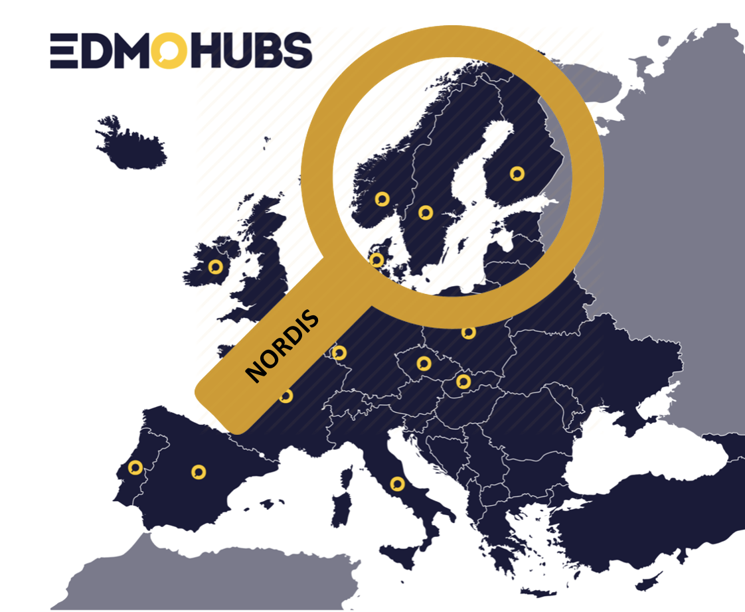
NORDIS (EU CEF funded)
8 Partners
Aarhus University
TjekDet
Uppsala University
Källkritikbyrån
University in Bergen
Faktisk.no
University of Helsinki
Faktabaari

Slide 4
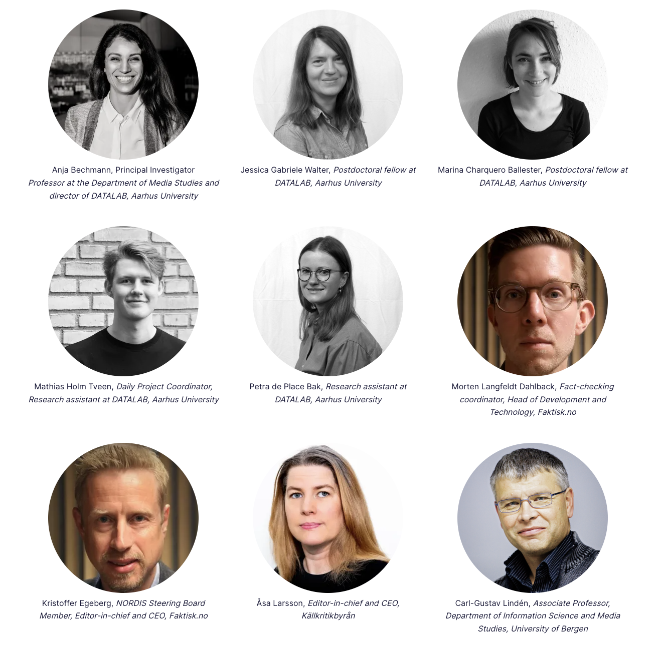
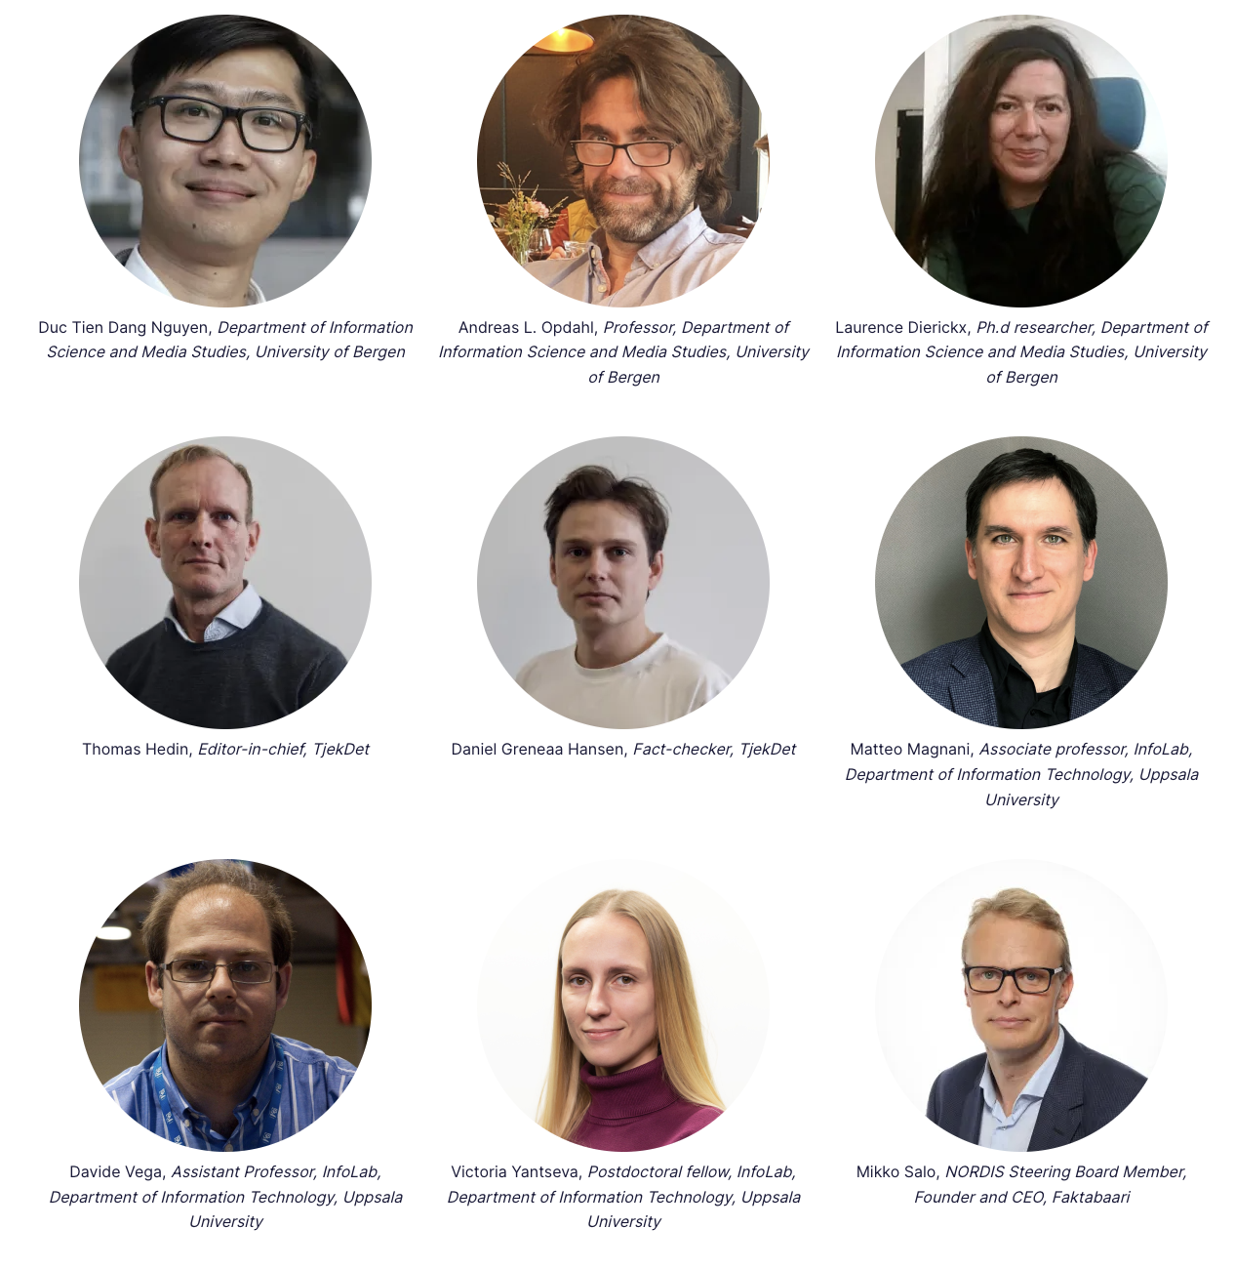
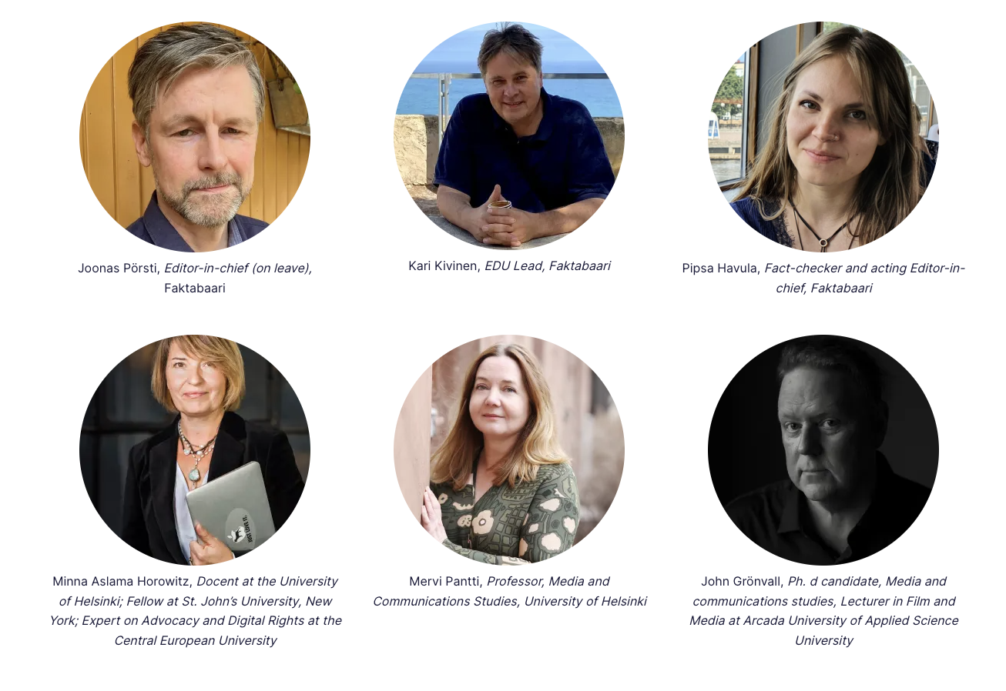
Interdisciplinarity+intersectionality
Sectors
Fields
Notes:
Plus ida, katrine, luna, andreas, anton and ulrich not pictured (came in later)

Slide 5
Vision for NORDIS
Create a model to tackle information disorder in digital media that
Adapts to challenges arising in Nordic welfare states
Consolidates and benefits all Nordic countries
Functions as best practice case in the European context
Build methodological and prototype technological infrastructure, scientific knowledge and capacity
Make resources freely available at national level and in the European Infrastructure via European Digital Media Observatory
Make sure to sustain the infrastructure beyond 3 years (now NORDIS2 with leadership/PI handed over from Denmark to Norway)

Slide 6
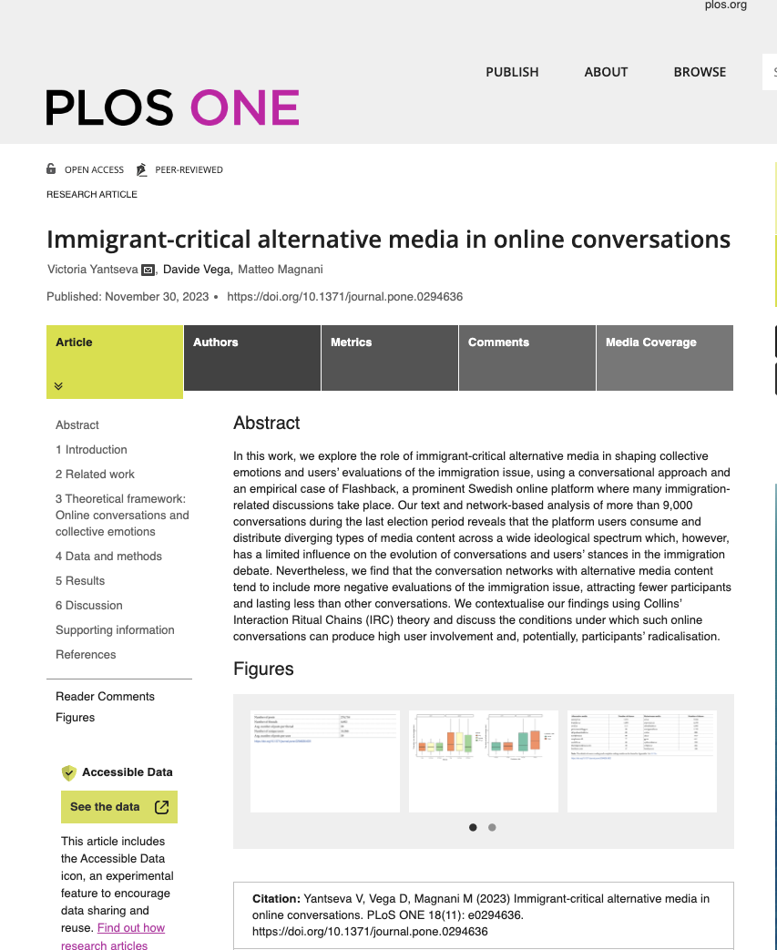
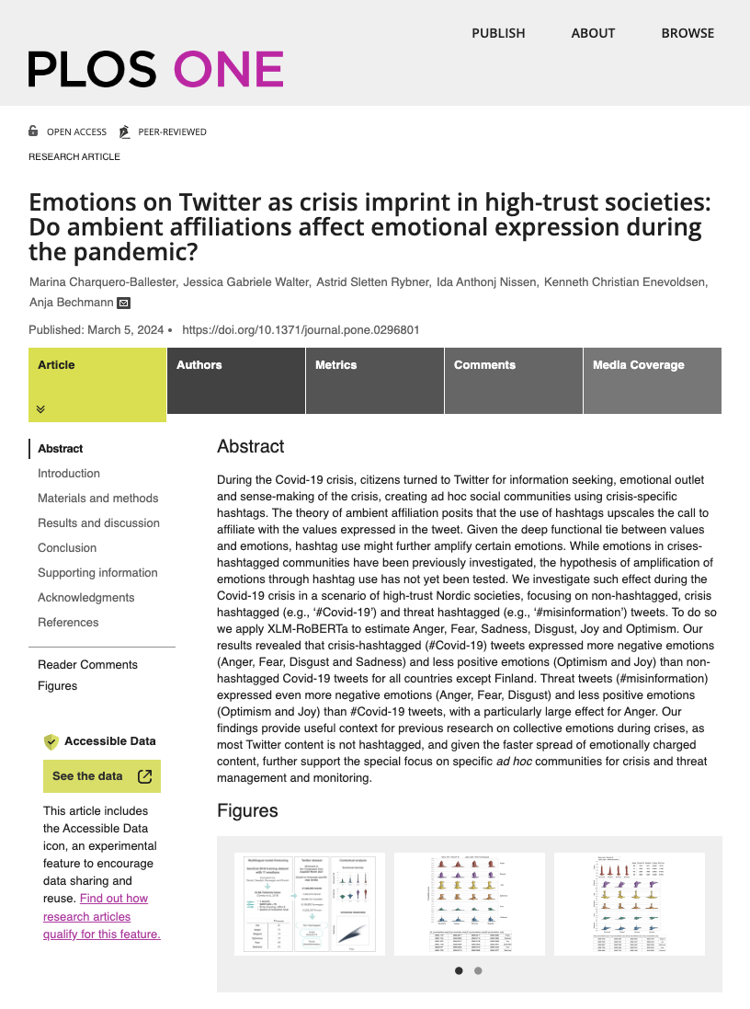
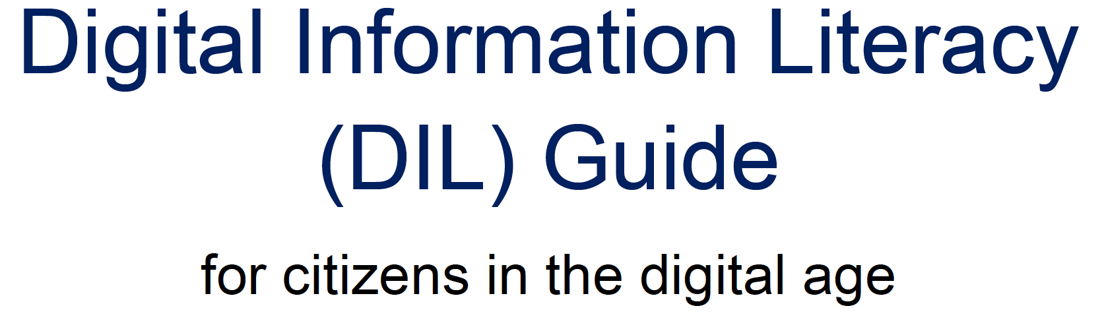
IMPACT: NORDIS CONSORTIUM
AWARDED THE CHYDENIUS MEDAL
Notes:
Faktisk has hosted Global Fact which gather all ifcn factcheckers in the world together with an academic track on disinformation. Along with this editor-in-chief, Kristoffer Egeberg is on the executive board of the international fact-checking network IFCN.
- During Global Fact 9 the Faktisk engaged the international fact-checking network in a training session, where different fact-checking tools identified by the Bergen researchers were tested.
The editor-in-chief of TjekDet, Thomas Hedin, has represented the Nordic fact-checkers and been a key factor in the establishing of the European Factchecking Standards Network. Furthermore, he has been nominated and elected as a board member in the executive board of the network.
Uni of Aarhus and Uni of Helsinki have been represented in the new Nordic Council of Ministers’ Think tank on the influence of big tech on the democratic debate as a preparation for regulatory negotiations on EU and international level to strengthen a united Nordic contribution
Literacy: The NORDIS Partners have developed extensive literacy material and campaigns.
Faktabaari’s Digital Information Literacy Guide includes 15 texts from 10 Finnish experts and is the most extensive guides specifically focused on the Nordic Context
Stop Tænk Tjek Det: Is a national campaign against dis-, mis- and malinformation that encourages danish people between the age of 14-29 to ”Stop before you share”, ”Think: is this to wild to be to” and ”Check who is saying this and why?” through videos, podcasts and educational material.
Käll Koll – Valet 2022: A program series on source criticism that delve deep into plots, claims and rumors circulating online to find out what's true - and what's false in the swedish 2022 election.
Uni of Aarhus and uni of Helsiniki has been engaging in the crafting and interpretation of the DSA both in terms of mapping the regulatory background in the nordic countries, officially commenting on the dsa and in the work of crafting the code of practice for disinformation guidelines
(mathias har vi noget på uppsala og bergen og k¨llkritikbyrån – eller er det fint nok? Tænker faktisk vi skal lade være med at nævne hvilken partner men bare give overblik – hvad tænker du?)
– Jeg tænker, at det er helt fint. Jeg kan se på vores noter, at de heller ikke highlightede andet relevant. Källkritik er også nævnt igennem deres literacy kampagne
Uni of Aarhus representing NORDIS in data access negotiations from EU with US government White House representatives (white house logo)

Slide 7
FACTCHECKERS: FAKTISK (NORWAY), TJEKDET (DENMARK), FAKTABAARI (FINLAND), KäLLKRITIKBYRÅN (SWEDEN)

Slide 8
NORDIS Fact-checking
The day-to-day fact-checking delivered a total of 649 fact-checks, exceeding the Grant Agreement target of 512 by almost 27%
content generated by NORDIS alone reached at least 5 million users, and at least 8 million page views
Constructed 3 large literacy campaigns and a proof-of-concept COLLABORATIVE FACTCHECK: Published article by four fact-checking organizations in four different countries

Slide 9
BERGEN UNIVERSITY (NORWAY)
UPPSALA UNIVERSITY (SWEDEN)
HELSINKI UNIVERSITY (FINLAND)
AARHUS UNIVERSITY (DENMARK)

Slide 10
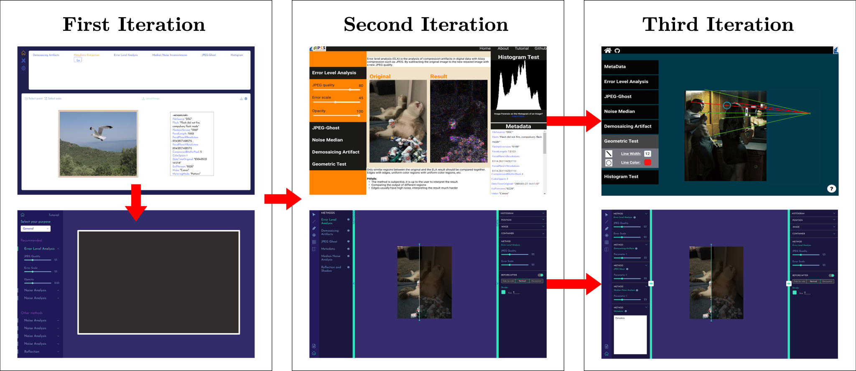
Network dissemination structures and radicalization of conversations – proof of concept methods to map them
BERGEN UNIVERSITY (NORWAY)
UPPSALA UNIVERSITY (SWEDEN)
HELSINKI UNIVERSITY (FINLAND)
AARHUS UNIVERSITY (DENMARK)
Prototypes of deep fake detection + factchecking tools and needs overview
Developed and tested AI model to detect six emotions on platforms across biggest four nordic languages + developed method for increasing transparency in factchecking infrastructure + monitoring exposure of misinformation on Facebook in all EU countries
Framework (32 expert interviews) for assessing the national capacities to counter disinformation from the perspective of citizens' communication rights + constructed Digital Literacy courses

Slide 11
AARHUS UNIVERSITY (DENMARK)

Slide 12
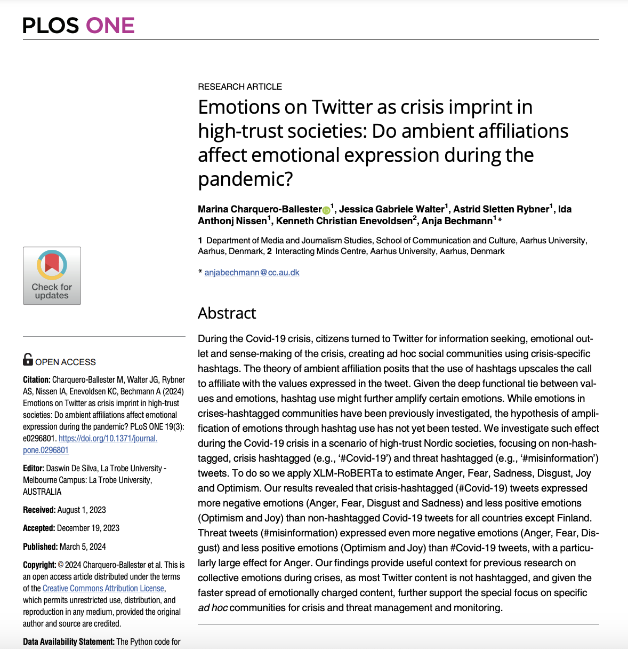
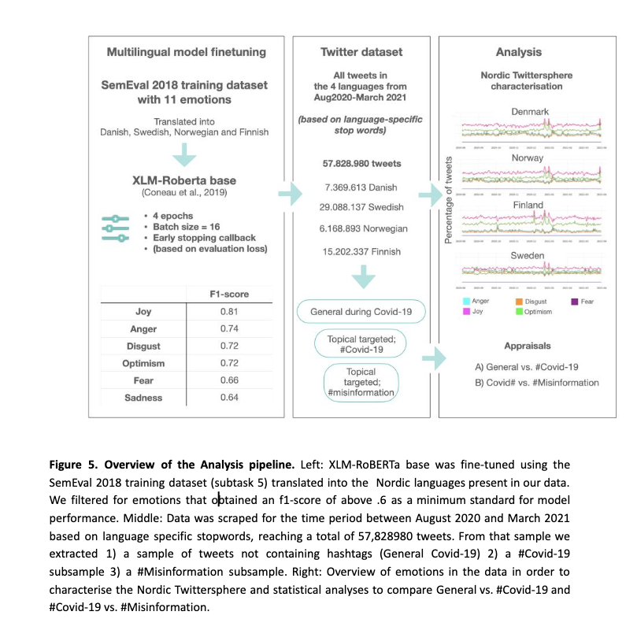
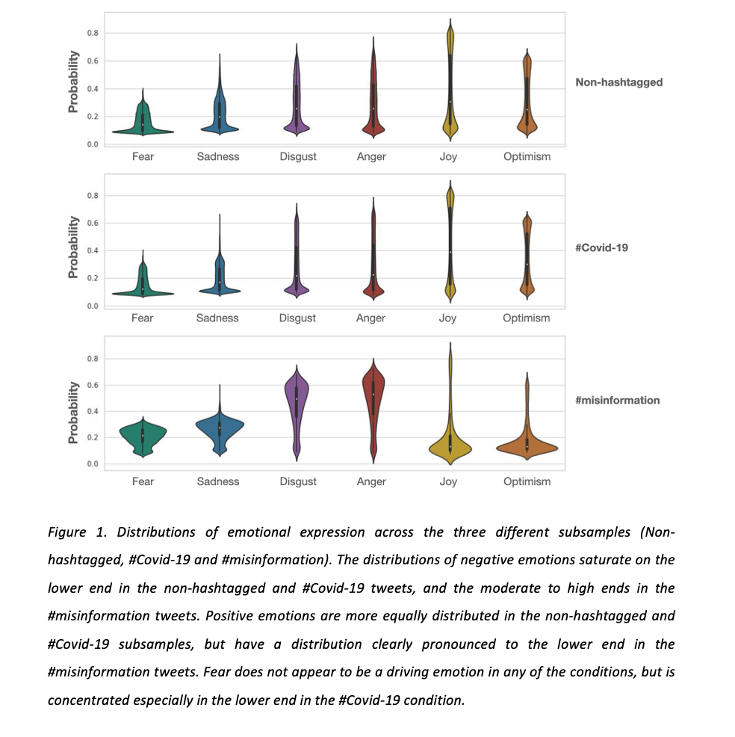
Misinformation=tweets with misinfo related hashtags
Notes:
During the pandemic, many people turned to Twitter for information seeking, emotional outlet and sense-making of the crisis, creating ad hoc social communities using crisis-specific hashtags (Burgess & Bruns).
While some researchers have investigated emotional talk in ad hoc social communities during the pandemic as a crisis imprint, differences in non-hashtagged, crisis hashtagged (e.g., ‘#Covid-19’) and crisis-within-crisis hashtagged (e.g., ‘#misinformation’) content has not been investigated.
We investigate such differences during the second wave of the Covid-19 pandemic in a scenario of high-trust societies integrated by the four largest Nordic countries. We focus on the theory of ambient affiliation through hashtag use (Zappavigna), and whether this phenomenon is related to differences in specific emotions.
presence of a hashtag, when compared with a non-hashtag example, expands the meaning potential of the tweet by making the coupling more available for search and more likely to be automatically followed by those subscribing to this tag, hence, becoming ‘louder’, ‘hyper-charged’, and making it more ‘bondable’. We look into the expression of emotions in high-trust societies in relation to crisis and crisis-within-crisis, but with a special focus on the interplay between emotional talk and ambient affiliation.
Analyses comparing across communities revealed that crisis-hashtagged (#Covid-19) tweets were accompanied by more negative emotions (Anger, Fear, Disgust and Sadness) and less positive emotions (Optimism and Joy) than non-hashtagged Covid-19 tweets for all countries except Finland. Crisis-within-crisis or #misinformation tweets were accompanied by even more negative emotions (Anger, Fear, Disgust) and less positive emotions Optimism and Joy) than #Covid-19 tweets, with a particularly large effect for Anger.
Our findings provide useful context for previous research on collective emotions during the pandemic and, given the faster spread of emotionally charged content, further support the special focus on specific ad hoc communities for crisis management and monitoring.
The work has provided a pretrained emotion detection transformer that can be used in Nordic languages for cross-country comparison and detection as part of the AI tools developed in the NORDIS project, along with other partner tools such as fake detection based on trucks and tanks and based on shadows etc.

Slide 13
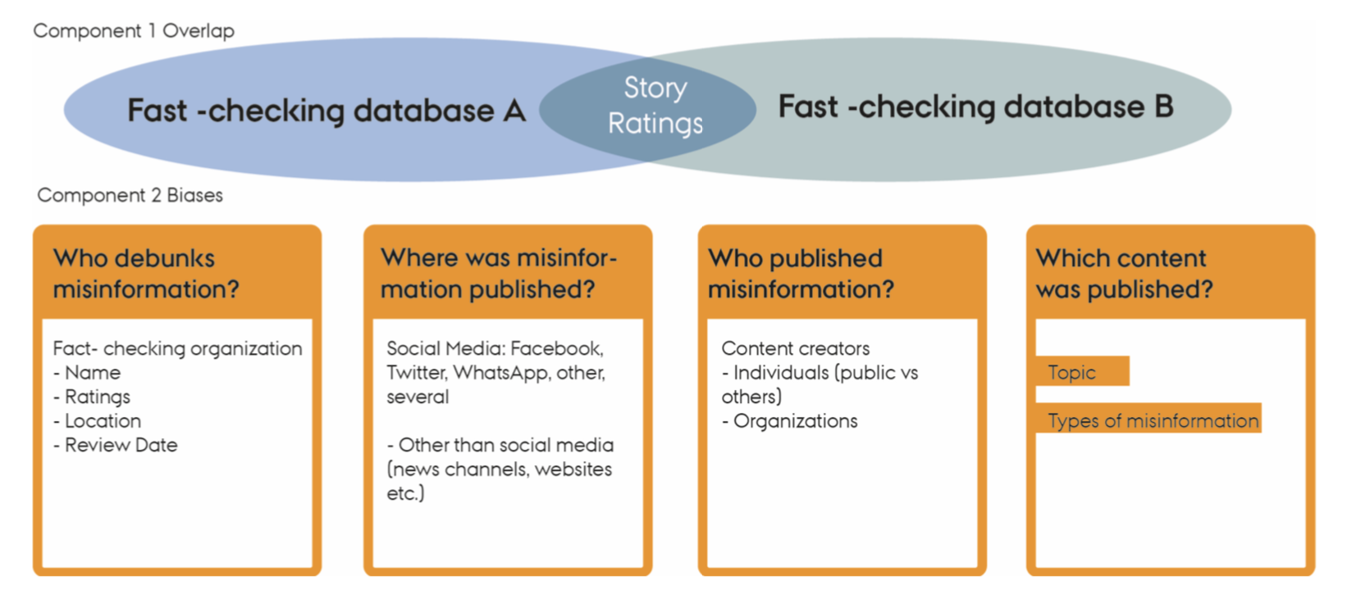
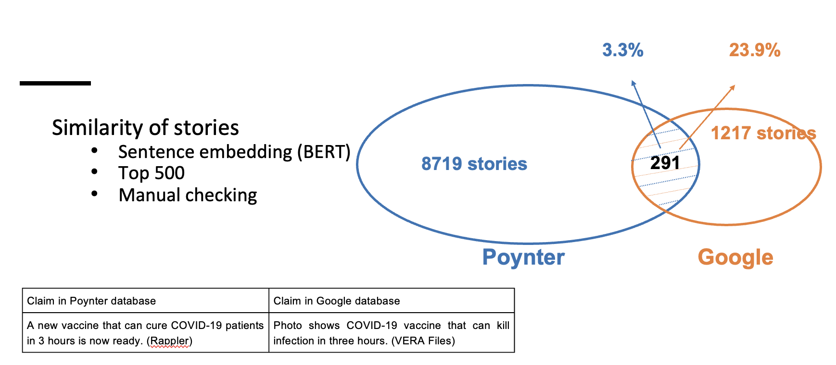

Slide 14
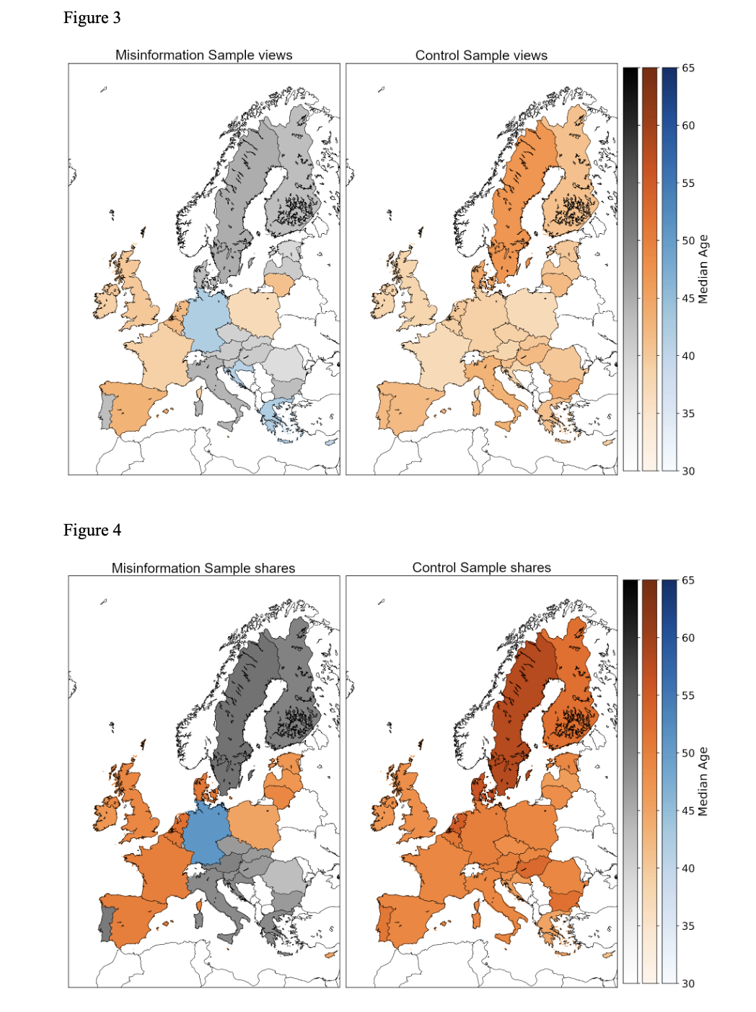
Misinformation exposure on Facebook in EU countries
(Social Science One dataset of 70 million URLs excl breakdown tables - January 2017 to November 2022)
There are regional differences in the demographic groups that are exposed to misinformation throughout the EU and UK
The exposure (viewing) demographic profile is younger than the sharing profile – the more demanding the older the profile (going from viewing, like, sharing, commenting)
women aged 35 to 44 were exposed to the most misinformation in the period, although males were overrepresented compared to a control sample. -> More females than males are viewing and engaging with misinformation
This should be kept in mind when developing misinformation interventions

Slide 15
IMPACT ASSESSMENT AND TAKE-AWAYS FROM NORDIS

Slide 16
NORDIS: a shared infrastructure model
Created a shared model for tackling information disorders in digital media to ensure transparency in democracies
The model builds on shared cultures and higher degree of literacy than rest of Europe so not directly transferable but tools are
The model (infrastructure) Benefits both NORDIS fact-checkers and researchers
Researchers: valuable insides into the practises of the NORDIS fact-checkers and fact-checking data
Fact-checkers:
Access to emotion detection tool for Nordic languages, overviews of networks between disinformation actors, implementing image detection, Establishing the fact-checking tools database (can be found on nordishub.eu)
Benefits of a stronger Nordic fact-checking network
Weekly fact-checker meetings to share insights and discuss findings and fact-checks in progress
Active communication channels: helps spot cross-propagation + produce collaborative factchecks
Especially beneficial to smaller fact-checking organisations
Notes:
Fact-checkers:
access to sentiment analysis tool for Nordic languages, overviews of networks between disinformation actors (we’re planning to run it on tweets directed at Norwegian MPs before the end of the year – maybe we’ll see some effects of Elon’s “amnesty”)
Establishing the fact-checking tools database, which has already resulted in a guide from Källkritikbyrån, Faktabaari and TjekDet.
Benefits of a stronger Nordic fact-checking network
Weekly fact-checker meetings to share insights and discuss findings and fact-checks in progress
Active communication channels: Strengthened ability to spot misinformation and contextualize it, especially in cases of cross-propagation (misinformation from country A inspires misinformation in country B)
Especially beneficial to smaller fact-checking organisations

Slide 17
Takeaway: Leading interdisciplinary projects
It is a strength that any given partner is interdisciplinary – if problems arise other partners can take over
This is especially important when data processing is required as these processes are almost impossible legally across countries at a fast pace
Should I do it again, I would:
prioritize to have a dedicated communication team member under PI-partner servicing all partners
insist on all academic reports being kept short as executive summaries referring to a full academic journal article preprint and not the opposite
Prioritize a more integrated and systematic use of advisory board and confirmed letters of support actors e.g. new threats and technology semester talks

Slide 18
Thank you!
Visit the NORDIS website!
www.nordishub.eu

Slide 19
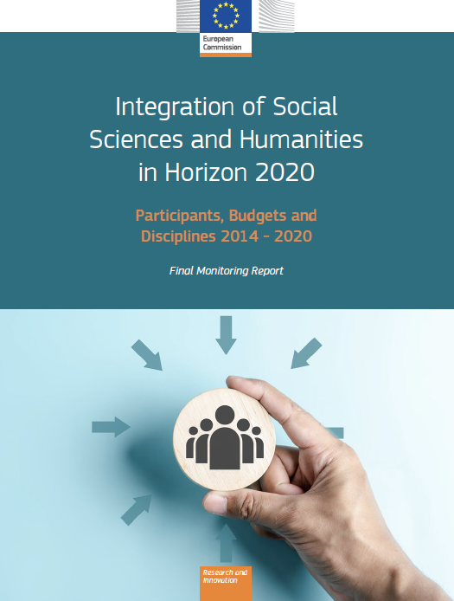
THE SEARCH FOR SSH…

Slide 20
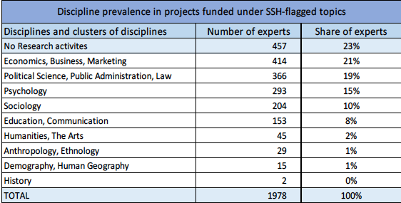
Slide of the data from the integration report showing how many projects and what proportion of the projects were ‘SSH’
Slide from the integration report showing the SSH topics that are most represented in the projects…to be contrasted with the slides using EurSciVoc and Scopus publications classifications to show which …

Slide 21
Jean Eric Pacquet SSH Integration report
The results are encouraging. The number of SSH-flagged topics, the number of SSH-intensive projects, the overall budget and the funding going to the SSH community all increased significantly compared with previous years. However, what matters in the end is the societal impact that greater SSH integration may have in the future. Thus, while the findings in this report give grounds for optimism, the future will have to confirm the degree of success achieved.
The effectiveness of SSH integration must be assessed from an increasingly qualitative (rather than quantitative) perspective. To this end, DG Research and Innovation (R&I) has been working intensively on key strategic orientations and key pathways to impact for the new Horizon Europe programme.

Slide 22
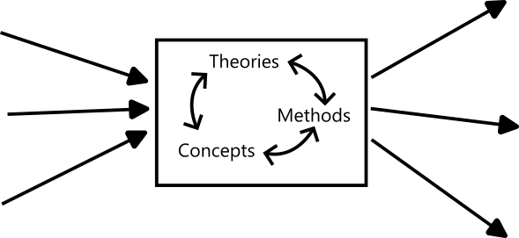
DIFFERENT ASPECTS OF SSH INTEGRATION
Who is involved?
What are the project’s concepts and topics (theories, methods, goals…)?
What are the results?
Notes:
There are different aspects to a project, and we can monitor SSH integration at these different levels. We think the following aspects are particularly relevant:
Who is involved in the project and to what extent do they work in SSH?
Does the project use theories, methods and concepts from SSH?
Do the results (such as publications) contribute to SSH?
While these aspects are related, they are not the same, and interdisciplinarity can manifest in different ways across them. This is why we propose to monitor SSH integration using a combination of approaches.

Slide 23
HORIZON 2020: SSH CLASSIFIED (EUROSCIVOC)
Notes:
THIS IS THE ESTIMATE OF THE SSH-ness of the societal challenges pillar in H2020. the high is – not surprisingly – SC6 with 68% of projects being SS and 5.3% Humanities and the lower the health challenge closely followed by SC3.3.

Slide 24
HORIZON 2020 SSH INTEGRATION REPORT: HEALTH (SC1)
10% Threshold
Horizon 2020 part | None | Weak | Fair | Good
SC1 | 36% | 13% | 21% | 30%
20% Threshold
Horizon 2020 part | None | Weak | Fair | Good
SC1 | 50% | 18% | 12% | 20%
Notes:
Taking our lead from the Commissions thorough assessment of SSH integration in H2020 we wanted to test thee report conclusions, and look for any lessons we can use to look for SSH in Horizon Europe.
One of the challenges we are conscious of is that the reporting cycle does not allow any conclusions or lesson’s learned to be taken into account in the design of successor programmes or for the ongoing implementation the current programme.
We chose the Health challenge for closer scrutiny according to an assumption that the Health programme has a very strong ‘social’ dimensions and should therefore have a meaningful contribution from SSH
Thresholds – that the SSH partners is more than 10%, the SSH partners budget is more than 10%, the proportion of PMs for SSH partners is more than 10 – plus two SSH disciplines involved. The 20% thresholds raises the bar to 20% for the same above indicators.
Report conclusions. The above extract from the report relating to Health challenge suggest that 50% of flagged topics under the Health challenge have a good/fair integration, on the basis that 10% of partners/budget/resources are from SSH partners. Our challenge to this approach is that the measure looks only for the input measures and not what is produced. In the remainder of this presentation we have searched for other methods to help find the SSH in the Frameworks programme. We start by testing some approaches on the complete set of data provided by H2020, and then use them to examine the progress made in Horizon Europe

Slide 25
HORIZON 2020: HEALTH CHALLENGE
Notes:
This first chart we look at the proportion of projects funded under the health challenge which – according to the EuroSciVoc classification of projects in CORDIS. This classification is based on a text analysis/NLP method looking at the projects funded and the text of the project objectives. We use this a move away from the ‘input’ measure of staffing of partners, towards the intended outputs, suggested in project OBJECTIVEs.
The chart shows in this method that the total proportion of projects with meaningful SSH is around 10% (9% SS and 1% H). In the next slide we drill down from this summary to detect SSH in the detail…

Slide 26
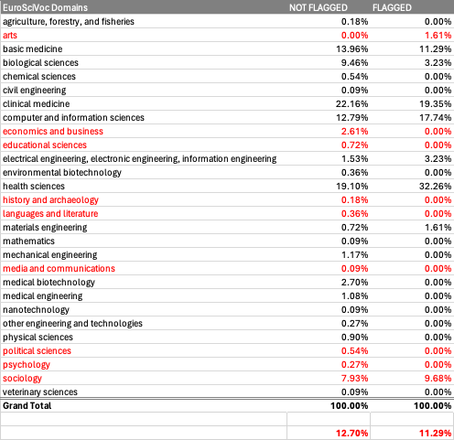
HORIZON 2020 HEALTH CHALLENGE: PROJECTS CLASSIFIED USING EuroSciVoc
Notes:
The SSH Flagged projects represent only 12% of the total projects funded under HEALTH challenge

Slide 27
HORIZON 2020 HEALTH CHALLENGE: FLAGGED TOPICS
Notes:
In this slide we have moved to a high level of definition using the EuroSciVoc classification to reveal the 25 sub-domain disciplinary areas in EuroSciVoc. We have also. Separated out the projects which are funded under the SSH FLAGGED TOPICS. According to our evidence the projects funded under FLAGGED TOPICS are about 12% of the total.
In the table on this slide we see that the projects funded under the FLAGGED TOPICS 20% have meaningful SSH component as described by the EuroSciVoc classification. Which is twice the rate of the non-flagged topics. Two further observations, that there is more SSH under the flagged topics of the HEALTH challenge, but it is still under 20%.
The second observation is that the FLAGGED TOPIC approach does not act positively for all SSH disciplines evenly – the table on the slide shows that sociology benefits significantly, alongwith Languages and Psychology. However, political science, economics, history, …. Are less present in the FLAGGED TOPICS than in the general cohort of projects.

Slide 28
HEALTH CHALLENGE: % OF SSH PUBLICATIONS
Notes:
For the next set of slides we are using the publications associated with the projects funded under H2020. publications represent the output or outcome of the projects and could provide stronger relationship to the purpose of the projects than some input measures.
In this method we look at the publications which are linked to projects under the Health challenge. To determine the academic field or discipline we can connect the JOURNALS where outputs are published and the classification of the journal according to the ASJC classification used by Scopus.
The chart here shows that the largest proportion of publications under the health challenge are published in ‘Medicine’ journals…the next slide provides moredetail

Slide 29
HEALTH CHALLENGE: % OF SSH PUBLICATIONS
Notes:
The table shows the proportion of publications in the ASJC disciplinary/topic areas. Here the proportions of SSH project project publications is significantly lower than suggested by the previous method. Here the proportion of SSH publications under the FLAGGED TOPICS is just 4%.
One caveat here is that further investigation is required as the rates of publication in some SSH fields compared to some of the STEM fields are different. However, it is unlikely to explain the difference suggested by EuroSciVoc projects – 20%

Slide 30
CLIMATE CHALLENGE: % OF SSH PUBLICATIONS
Notes:
The table shows the proportion of publications in the ASJC disciplinary/topic areas. Here the proportions of SSH project project publications for the climate challenge under the FLAGGED TOPICS is just 7%.
One caveat here is that further investigation is required as the rates of publication in some SSH fields compared to some of the STEM fields are different. However, it is unlikely to explain the difference suggested by EuroSciVoc projects – 20%

Slide 31
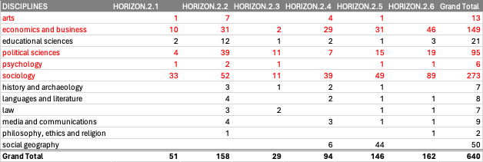
HORIZON EUROPE - WHERE IS THE SSH: PROJECTS WITH SSH (EUROSCIVOC)
Notes:
Turning now to Horizon Europe using some of the methods we described in the first section. We cannot use the publications from projects as Heu is still relatively early in its lifecycle and newly funded projects are unlikely to have produced many research publications at this point. The following analaysis relies on the the EuroSciVoc approach shown before and the TOPIC analysis.
We want to bear in mind here that the perhaps none of the methods provide sufficient evidence in any single approach but here we want to encourage the use of mixed methods which combine qualitative and quantitative approaches in the assessment of a programme like Horison Europe
This table shows the presence of SSH projects across all of the CLUSTERS of HORISON EUROPE. Itshows that the largest presence is drawn from SOCIOLOGY. These are the absolute numbers and not proportions so cannot be used to directly compare, but it does show that other than CLUSTER 2 there is presence of SSH in CLUSTER 5 CLIMATE ENRGY MOBILITY and CLUSTER 6 FOOD.

Slide 32
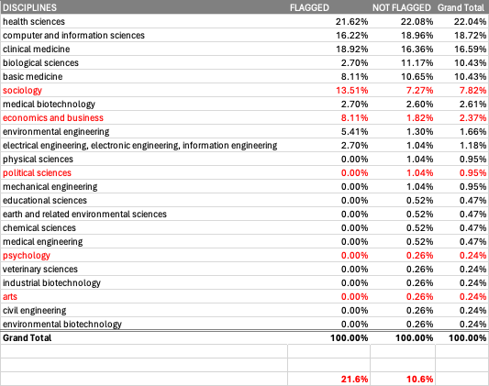
HORIZON EUROPE HEALTH CLUSTER: PROJECTS CLASSIFIED BY EuroSciVoc
Notes:
This slide shows that under the flagged topis aroud 20% of projects using the Euroscivoc classification, look to have meaningful SSH, this drops to 10% in the general programme. This suggest that FLAGGING does enscourage more SSH presence in projects.
However, not all disciplines are affected in the same way under the FLAGGING approach. There is more presence of Sociology and Economics under the flagged topics. Byt for political science, psychology or Arts they are less present than under projects which had no special expectation of SSH presecenece.

Slide 33
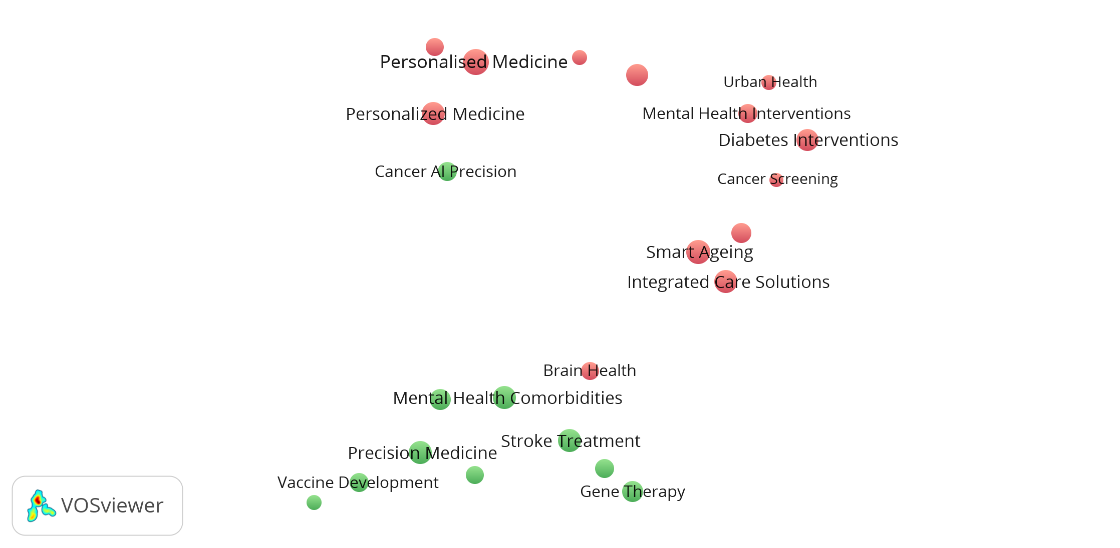
HEALTH CHALLENGE: TOPICS
Label: Global Health Response
Long label: Global Health Response to Infectious Pandemics
Description: This cluster of projects focuses on a global health response to infectious pandemics, particularly addressing topics such as pandemic modeling, e-health, vaccine hesitancy, epidemic intelligence, and implementation research to enhance public health preparedness and response. Various multidisciplinary networks and alliances have been established to combat the spread of infectious diseases and improve healthcare systems worldwide.
Terms: covid | 19 | research | outbreak | response | public | health | preparedness | social | cov
Notes:
This is a ‘map’, a visual representation of the main topics addressed in the Health challenge. Each bubble represents a set of related projects (10 to 35). The map is constructed by text mining the project descriptions. We come back later to how the map was constructed in a bit more detail.
Topics that are more closely related are positioned closer to each other. For readability, not all topic labels are shown. But note that we have a bit more info for each topic (longer label, description, most salient terms).
Note personalized medicine vs personalized medicine → Why? Former mostly tied to ICPerMed (International Consortium for Personalised Medicine).
QR code = interactive version: zoom, read descriptions, …

Slide 34
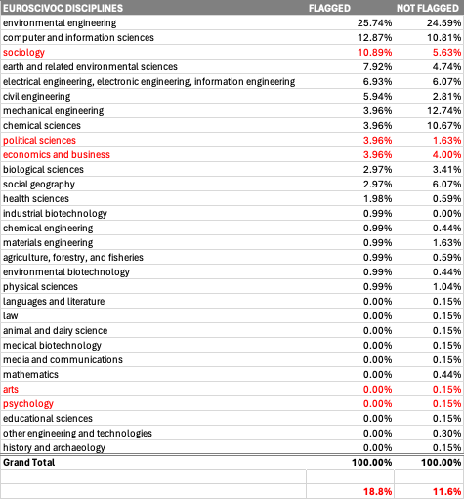
HORIZON EUROPE CLIMATE CLUSTER: PROJECTS CLASSIFIED BY EuroSciVoc
Notes:
This slide shows that under the flagged topis aroud 20% of projects using the Euroscivoc classification, look to have meaningful SSH, this drops to 10% in the general programme. This suggest that FLAGGING does enscourage more SSH presence in projects.
However, not all disciplines are affected in the same way under the FLAGGING approach. There is more presence of Sociology and Economics under the flagged topics. Byt for political science, psychology or Arts they are less present than under projects which had no special expectation of SSH presecenece.

Slide 35
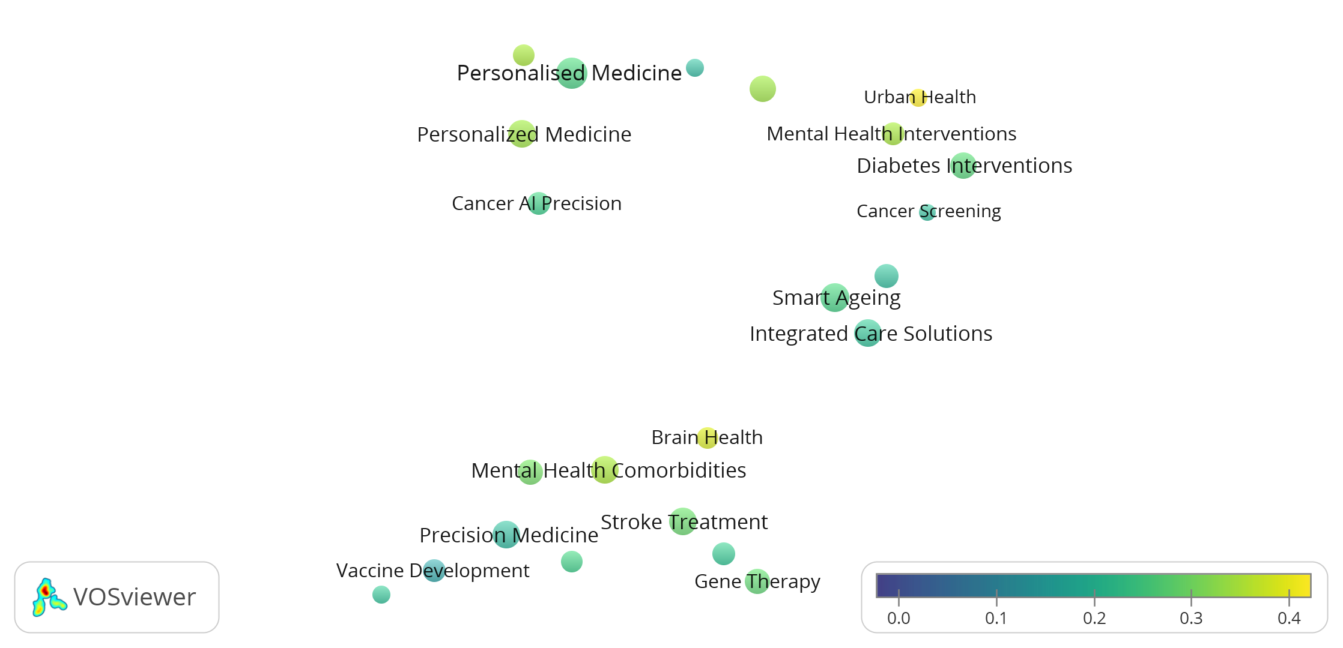
HEALTH CHALLENGE: TOPICS
Topic colour indicates how close textual project descriptions are to SSH.
Notes:
Different approach, based on textual description of project. The precise numbers here are harder to interpret, but anything above, say, 0,3 is close to SSH.
Note the Urban health cluster, which looks at influence of urban design and city environments on mental and physical health. This is a topic where interdisciplinary interactions between SSH (social and economic geography, sociology, psychology) and health sciences are crucial.

Slide 36
TOPIC ANALYSIS: STEPS
Notes:
We saw some results of topic analysis for the health challenge in Horizon 2020 before. Now I’d like to show you some of the results we obtain with the same method in Horizon Europe. But what is the method exactly?
- Based on our work on discerning topics in publication databases based on textual abstracts
Five steps:
1) We start from the project objectives. This is publicly available as open data (great!).
2) All projects within a cluster are processed together to create embeddings. These are a numerical or mathematical representation of what the text is about. You can think of them as coordinates, such that closely related texts are also found close to each other.
3) Because some embeddings (projects) are closer to each other, we can group them into topics.
4) If we reduce the number of dimensions to 2, we can visualize the relations between topics.
5) LLMS, like ChatGPT, are good at summarizing text. We show GPT which projects are inside a topic and ask it to label and describe the topic.

Slide 37
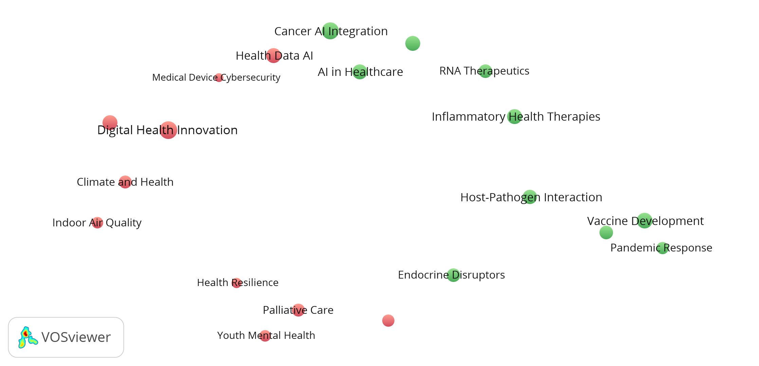
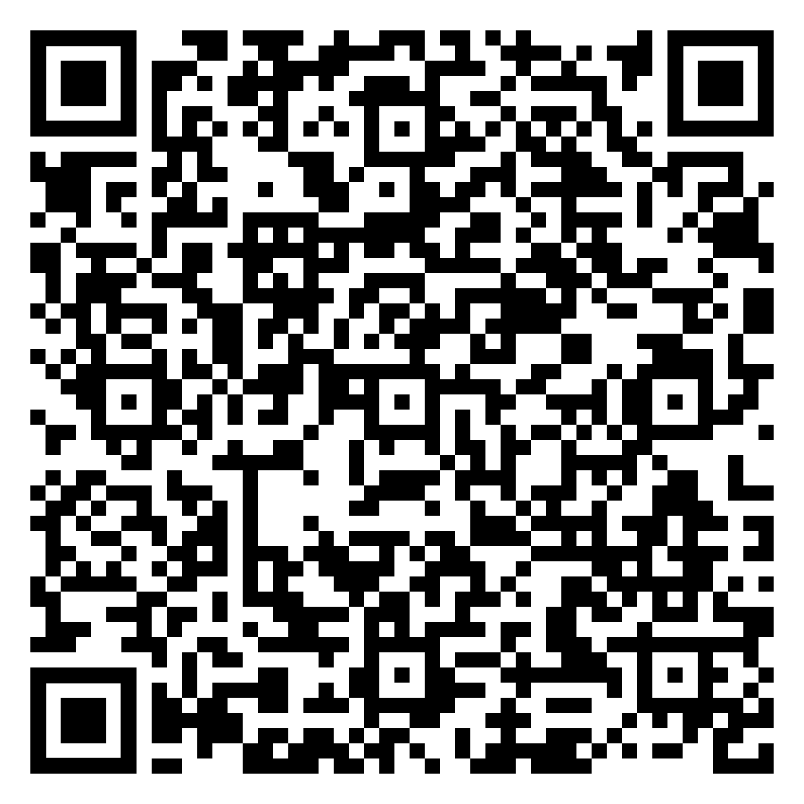
HORIZON-HLTH: topics
Notes:
We will, however, focus on the topic level. Some topics we encountered in the health challenge of H2020 reappear here: the pandemic and vaccination, AI in healthcare, personalized medicine…

Slide 38
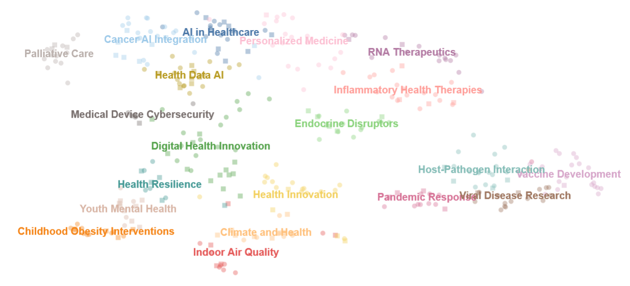
HORIZON-HLTH
Notes:
This means we could even drill down to the level of individual projects. Here, every dot is one project (349 in total) and the different colours represent different topics (20 in total).

Slide 39
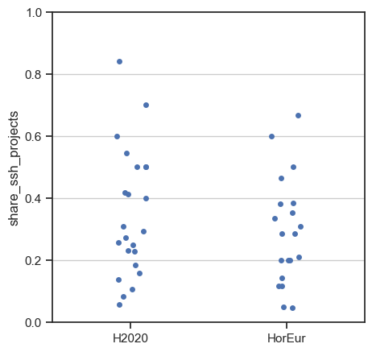
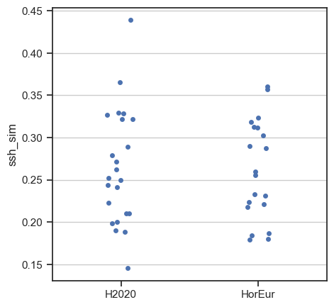
HORIZON EUROPE vs HORIZON 2020: HEALTH
Has SSH integration improved compared to H2020?
Share SSH projects
Textual similarity to SSH
Notes:
We looked at Health in H2020 and Horizon Europe, which raises the question: Has SSH integration improved if we compare the two?

Slide 40
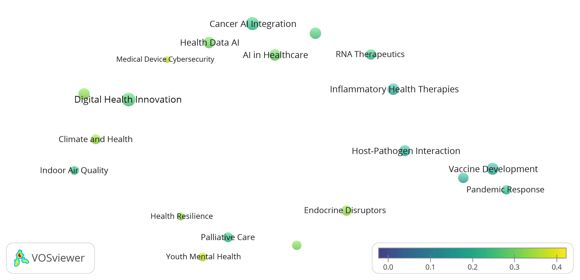
HORIZON-HLTH – textual similarity to SSH
Notes:
From the prespective of textual proximity to SSH, some other topics appear close, even though they’re not recognized as involving SSH in euroSciVoc.
Medical Device Cybersecurity: possibly because a number of projects also focus on regulatory aspects?
Endocrine Disruptors: chemicals affecting hormones and growth, several projects focusing on mental health

Slide 41
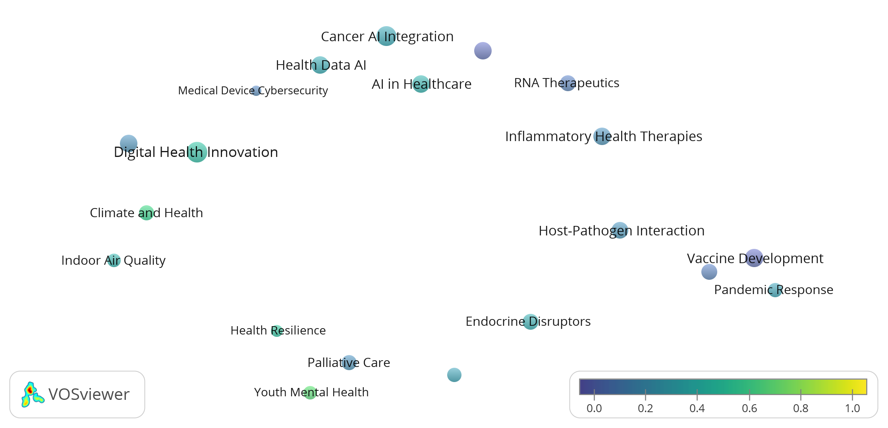
HORIZON-HLTH – share of SSH projects
Notes:
From the perspective of SSH projects, we find two topics with more than half of the projects involving SSH: Climate and Health (60%), and Youth Mental Health (67%).
Health Resilience has exactly 50% of SSH-involved projects.

Slide 42
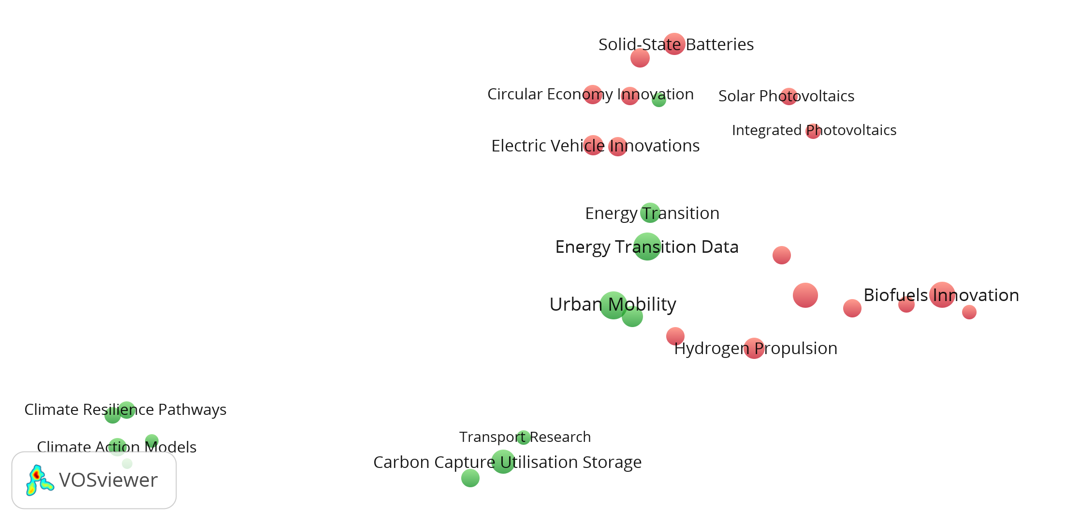
HORIZON-CL5: climate, energy & mobility
Notes:
Left: climate
Top and right: energy
Inbetween: mobility
Where do YOU think SSH integration will be most visible?

Slide 43
EASSH RECOMMENDATIONS
Our proposition is to encourage the use of more appropriate methods to assess the SSH integration
We encourage the use of ‘qualitative’ methods to be used and given equal weighting in ‘mixed method’ approaches to assessment
We encourage that more research on research is required to better understand the interplay in these issues
As multi-disciplinarity becomes more present in research investment programmes at MS and EU levels we encourage the use of more powerful methods
Data collection is critical. The ‘meta-data’ collected should be done as a result of the data collection exercise of a research project, not as administrative information which then struggles to be useful for enquiries and assessment
We call on funders to adopt an ‘open’ attitude to data – as they encourage us to make our scientific data ‘open’
Is there a correlation between the N/A publications and the SSH-ness of a project?

Slide 44
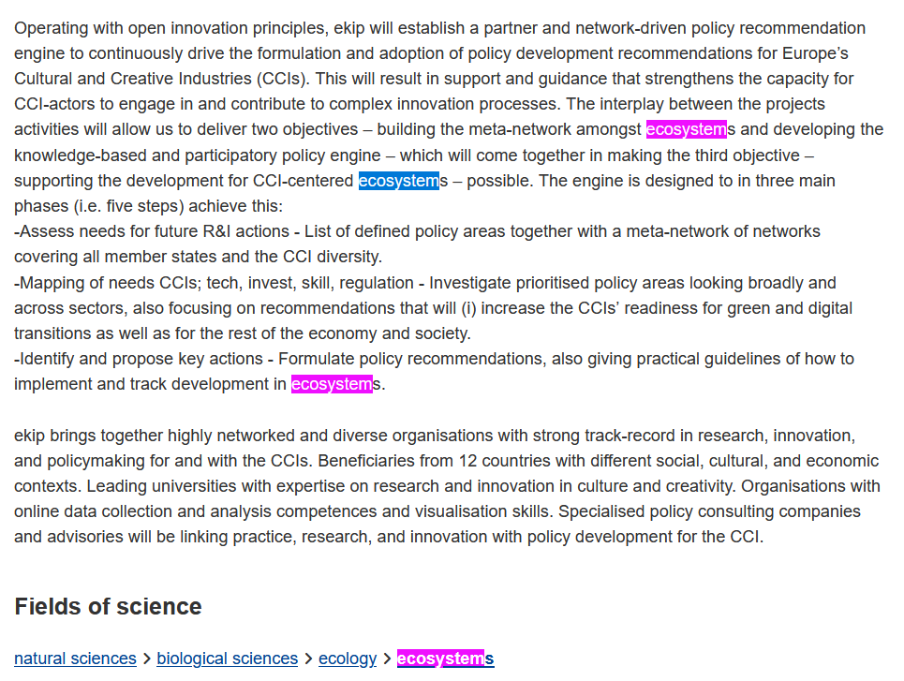
Notes:
Bonus slide: a good exmaple of where EuroSciVoc approach fails
This project is about policy for Europe’s cultural and creative industries, and is firmly embedded in various SSH disciplines. The system, however, only recognizes the term “ecosystems” and places the project in Biology…

Slide 45
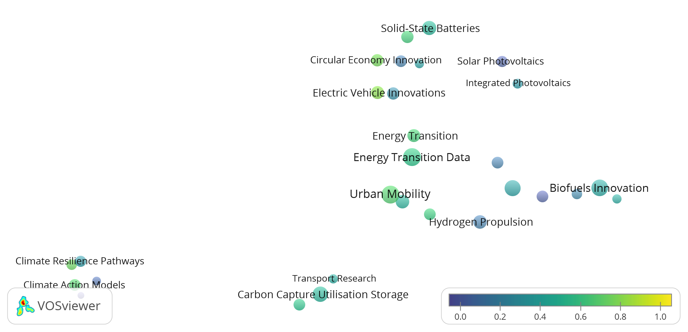
HORIZON-CL5 – share of SSH projects
Notes:
Circular economy
Electric vehicle innovations ->”electric vehicles” is topic under “social geography”, though projects under this topic seem to be more focused on technical issues.
In the bottom left corner:
Sustainable Land-use Strategies -> holistic evaluation of environmental and land-use policies
Climate Action Models -> behavioural change, policy adaptation… for climate action

Slide 46
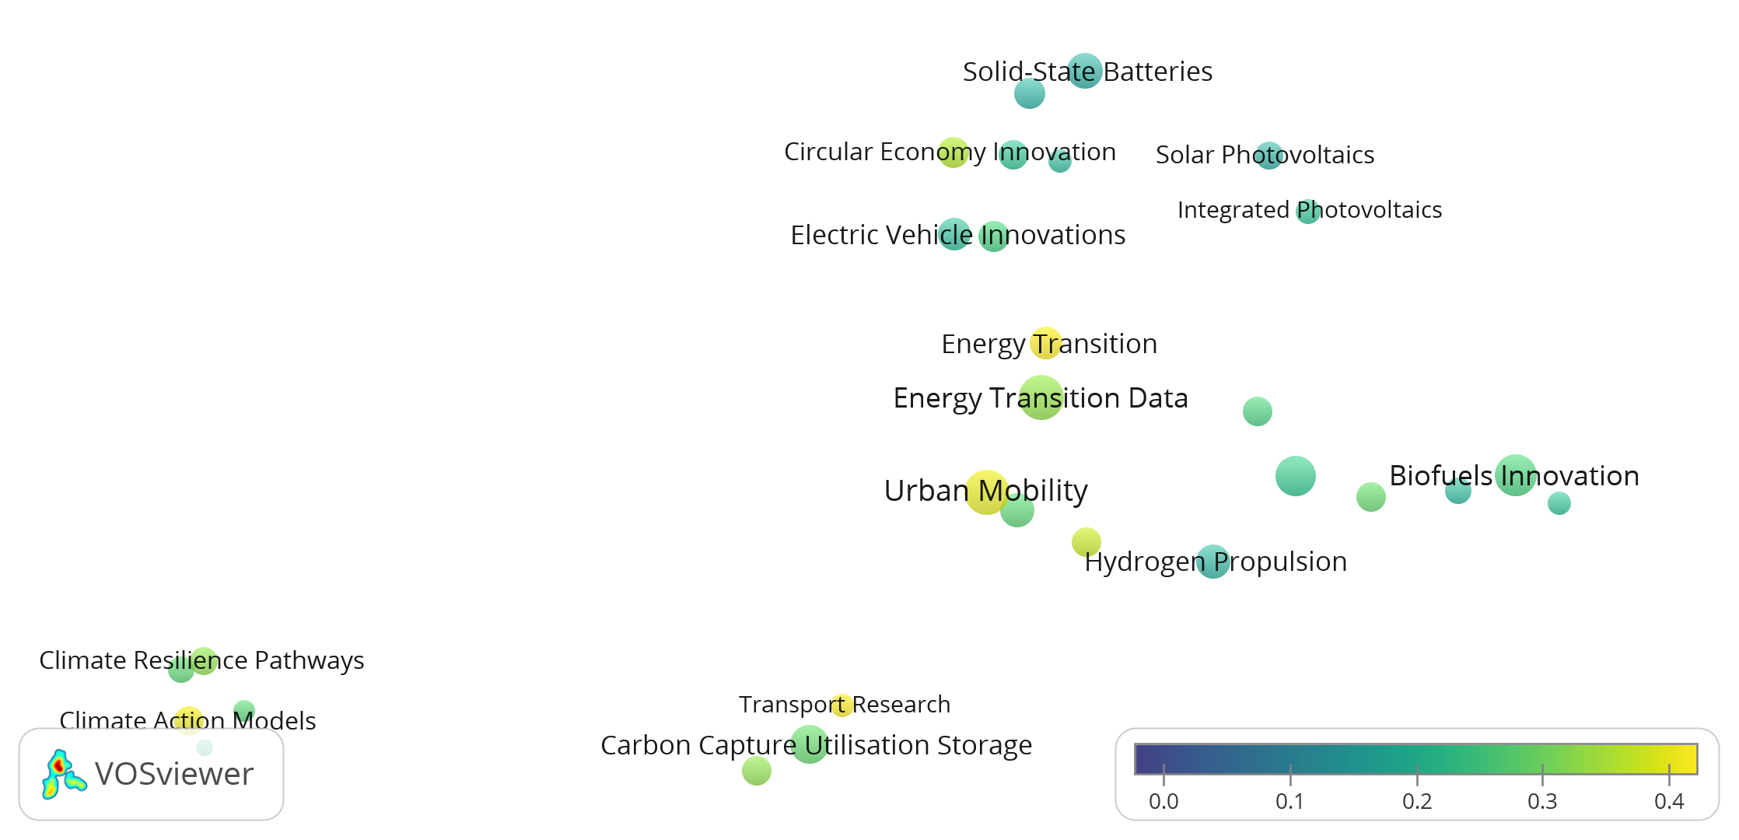
HORIZON-CL5 – proximity to SSH
Notes:
Transport Research, Urban Mobility

Slide 47
Recommendations from integration report
In order to ensure effective cross-cutting SSH integration we have made a number of proposals, which are currently under negotiation.
- A revisited evaluation process under the excellence as well as impact criteria.
- A novel category of inter-disciplinary experts for panel evaluations of SSH flagged projects.
- New cross-cluster complementarities and synergies in terms of SSH presence across the entire new programme.
- A new key deliverable in the form of a societal development plan (SDP), outlining the contribution of SSH fields to the project in question. In SSH-relevant projects, an SDP should set out how the consortium wants to achieve the societal goals of the project, in particular by the strategic deployment of SSH knowledge and expertise. Such an SDP could become a key deliverable, and thus have financial implications for the project. This and other matters are currently under discussion in relation to the future evaluation and implementation of projects in Horizon Europe.

Slide 48
Audience’s observations on the data analysis
Res on Res methods provide tools for SSH integration analysis
Some flagged topics show even less integration of SSH than non-flagged topics in the same cluster
Monitoring of interdisciplinarity could be pursued collecting the right medadata
CL2 is a truly interdisciplinary cluster with a more balanced participation of all disciplines
Projects awarded in CL1 show a mismatch between call aims and their objectives: is a problem of call design or call evaluation?
Evaluators’ profiles no longer available
CL5

Slide 49
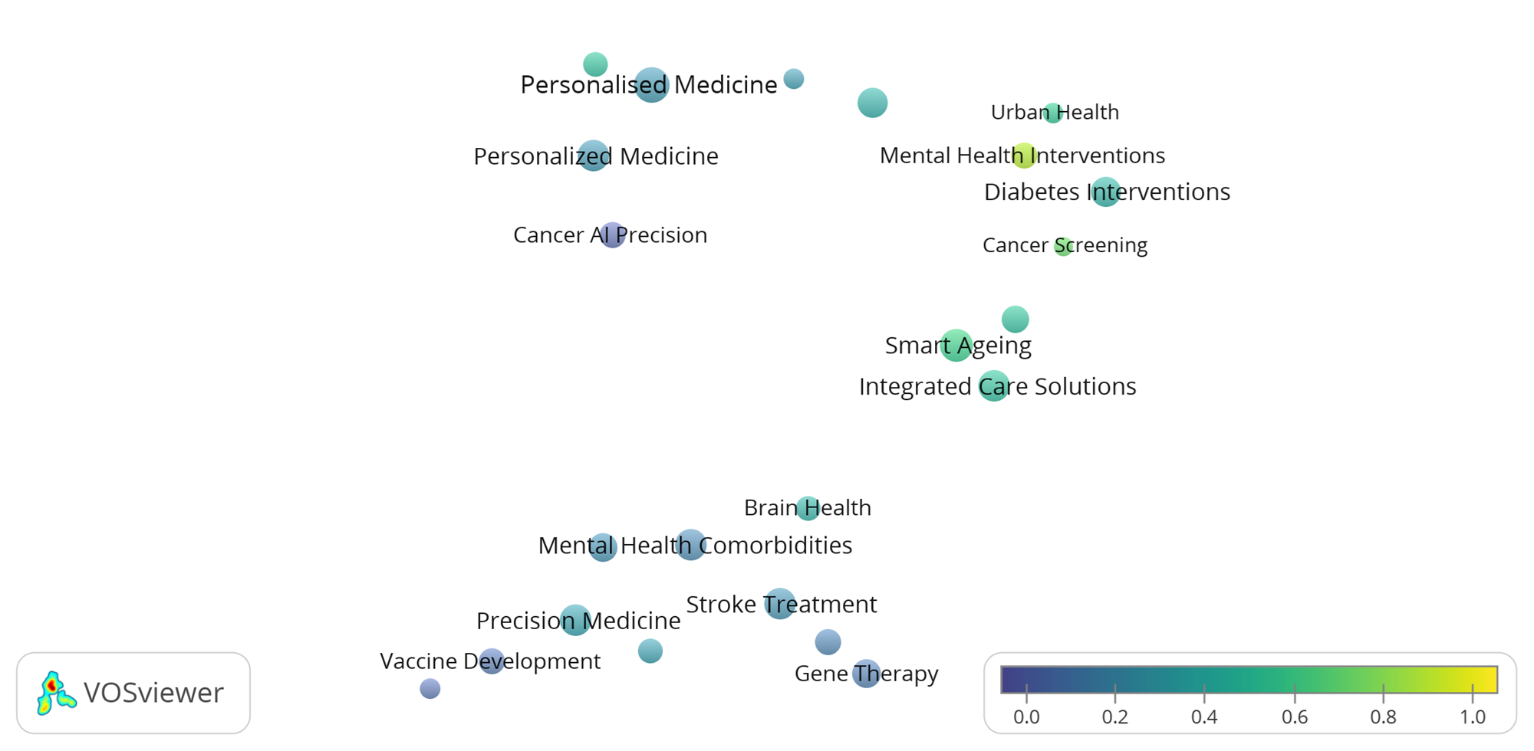
HEALTH CHALLENGE: TOPICS
Topic colour indicates share of projects involving SSH (according to EuroSciVoc).
Notes:
We looked at two ways of assessing the involvement of SSH in each topic. Here, the color of a topic indicates the share of projects that have at least one SSH classification.
Two topics relating to mental health: mental health interventions (80% SSH) and mental health comorbidities (20% SSH; relations to physical health).

